Slide 1
Goals (at least my goals)
Assemble genome
Find sex marker
Estimate effective population size

Slide 2
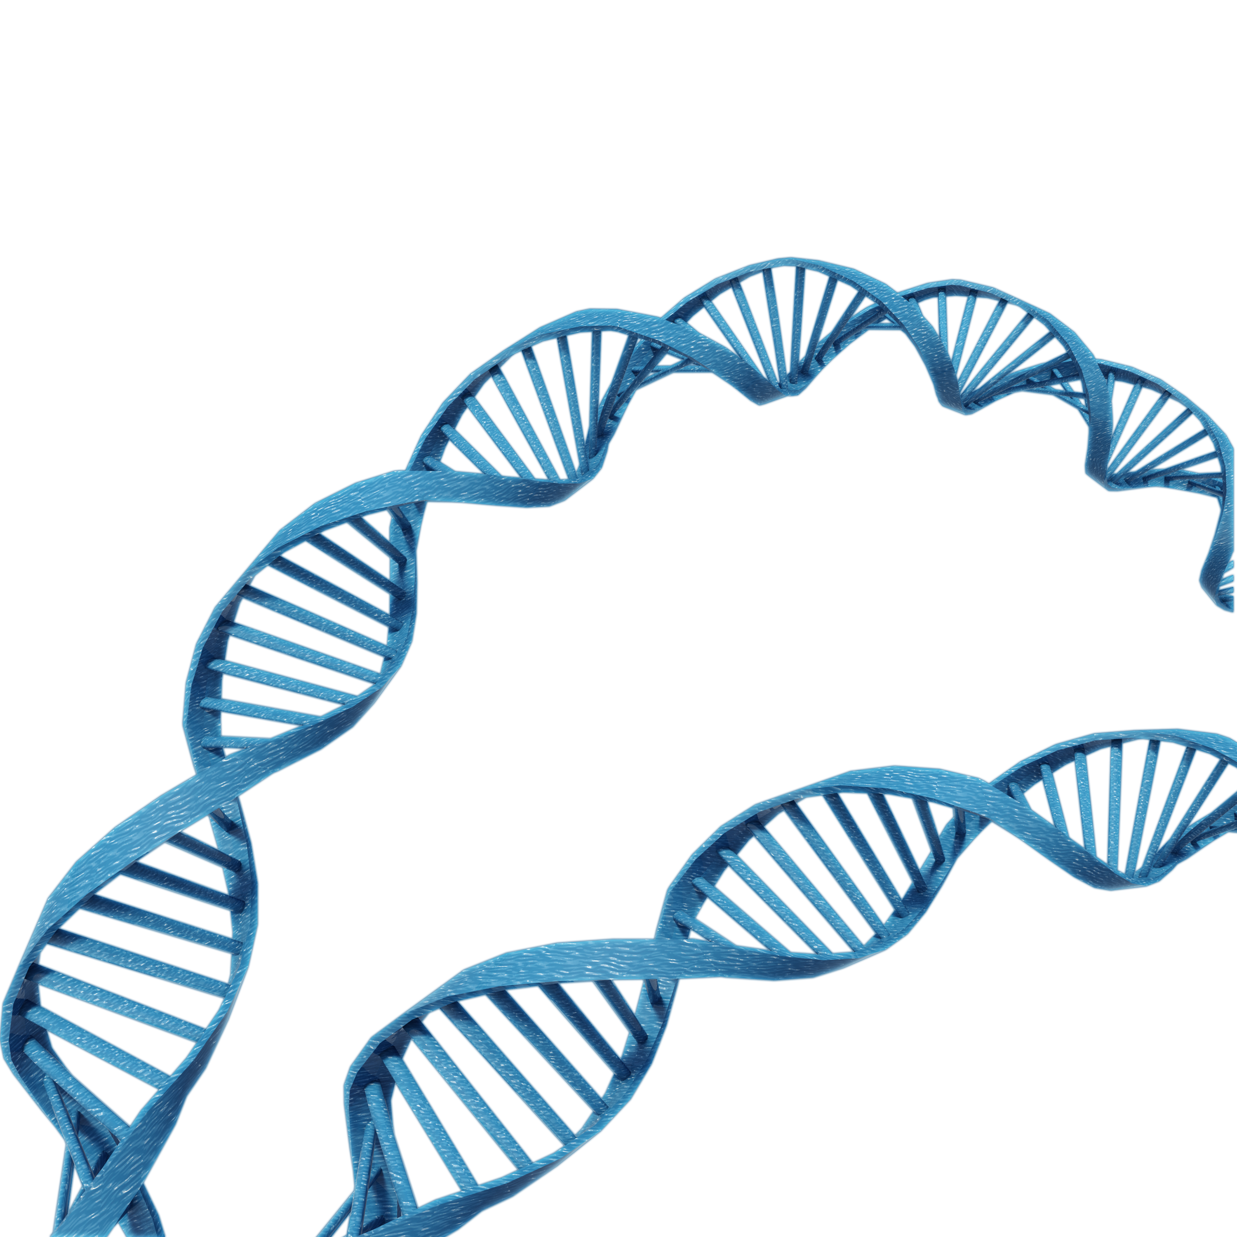
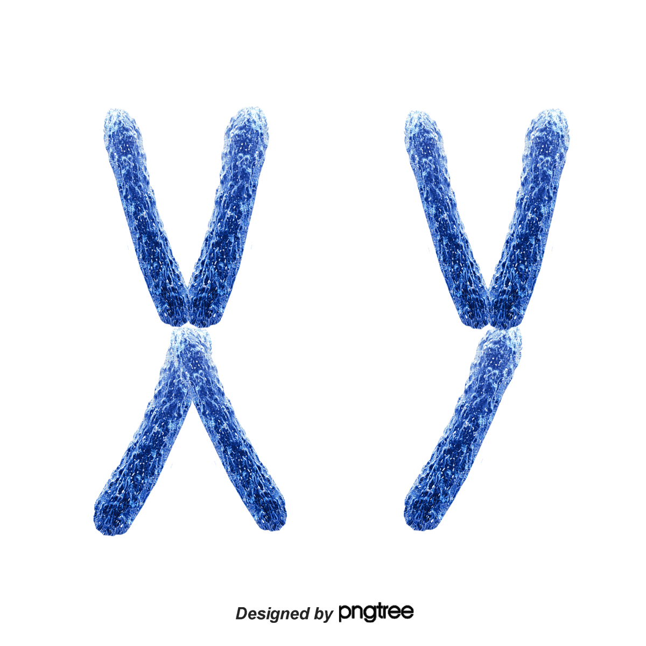
Genomes are very large
nucleus
A
T
T
C
G
T
C
G
A
C
C
G
G
T
A
A
C
G
A
A

Slide 3
Can capture all of the genome by using multiple types of sequencing technologies
Use more current sequencing technology to create a high-quality genome assembly
long reads
hi-c
A
T
T
C
G
T
C
G
A
C
C
G
G
T
A
A
C
G
A
A
linked reads

Slide 4
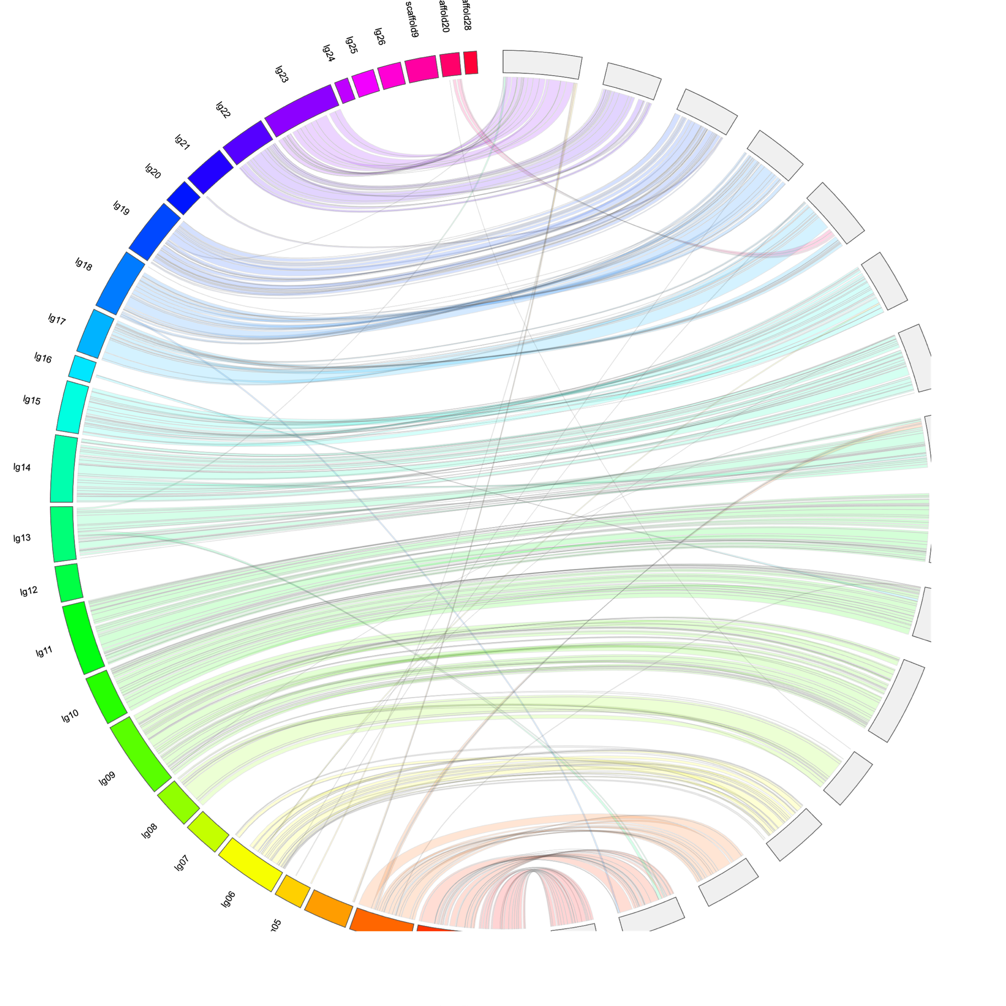
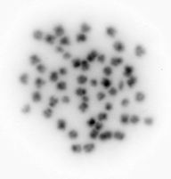
We achieved two high quality assemblies
One Male
One Female
Both assist in validating each other
Number of chromosomes validated with karyotype
Notes:
Some

Slide 5
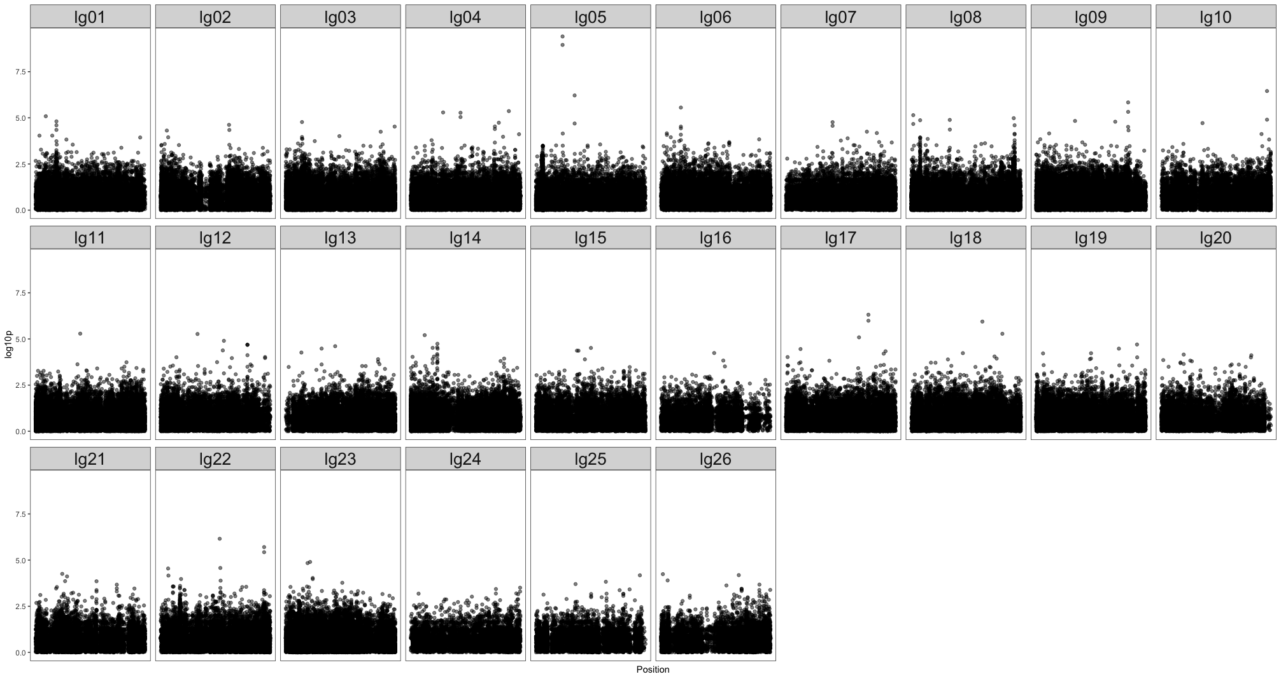
What can we do with this new genome?

Slide 6
Estimate the effective population size of wild delta smelt
Effective population size (N_{E}) determines how quickly populations are losing genetic diversity
50:500 rule
Can look at historical or contemporary N_{E}
Historical N_{E} is usually fairly stable
Contemporary N_{E} can give the effective population size of just a few generations back
Notes:
Definition: the number of individuals that an idealized population would need to have in order for a specified quantity of interest to be the same in the idealized population as in the real population
Genetic diversity is really important for populations to persist. New diversity comes from mutation so when you have a really small population you won’t see
Covid population is so huge so you get a bunch of mutation and the virus can adapt and respond to new environments
Larger population has greater genetic diversity, smaller populations have less genetic diversity
A common rule of thumb is the 50:500 rule––wild populations need to have a Ne of 500 to persist
Historical Ne is fairly stable unless there is a massive alteration to a population
Markers can’t be close together

Slide 7
Historical datasets
2208 wild fish from 1993 – 2016
RAD sequencing for each fish
Gives you data roughly every 65,000 base pairs
Initial estimates used genome assembled from RAD sequencing
RAD sequencing
Notes:
First pass on effective population size just using RAD data
Simplify––we had a big dataset but without the reference genome analysis was suboptimal

Slide 8
Historical N_{E} using RAD assembly
Notes:
We didn’t have a genome assembly so Y-axis is very unreliable due to the noise from not having an assembly

Slide 9
Contemporary N_{E} using RAD assembly
Notes:
Esitmates get smaller and have error bars as we approach more recent generations
We might expect this if a population shrinks
In order to accurately estimate Ne we needto make sure that markers are on separate chromosomes and are not dependent on one another––they need to not me physically close to each other

Slide 10
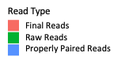
How much information did we glean?
Birth Year | Average Alignment | Birth Year | Average Alignment
1993 | 35.3% | 2007 | 80.8%
1995 | 74.5% | 2008 | 80.8%
1996 | 69.6% | 2009 | 79.7%
1997 | 65.7% | 2010 | 78.0%
1998 | 70.7% | 2011 | 77.7%
1999 | 74.0% | 2012 | 77.7%
2000 | 70.3% | 2013 | 77.0%
2002 | 81.4% | 2014 | 77.6%
2004 | 81.2% | 2015 | 78.8%
2006 | 80.9% | 2016 | 78.7%
 |  | All Years Combine | 78.0%
Notes:
Something that may lead to technical issues is that we are not getting all of the information that we can from our data. We can only use markers that align in all individual and here you can see that alignments rates are fairly low
–– over 20% of reads didn’t align to our de novo RAD seq based assembly

Slide 11
New data…!
Genome!
420 wild fish from 2017 – 2018
RAD sequencing for each fish
Notes:
2 fish where we sequenced the entire genome with complete resolution––interrogating 500 million positions in the genome very thoroughly
Had over 2500 samples where we sequenced with more sparse coverage––probably interrogating less than a million positions

Slide 12
Comparison metrics
Estimated genome size = 465 Mbp
 | RAD Assembly | New Assembly
Assembly Length | 12,905,745 bp | 437,273,953 bp
% of Estimated Genome | 2.58% | 94.4%
Average Length | 472 bp | 1,162,963 bp
Number | 27,297 | 376
New Assembly
DNA segment
Notes:
Put in human genome stats?

Slide 13
Better alignments…
 | RAD Assembly Alignments | New Assembly Alignments
All Years Combine | 78.0% | 92.6%
Better estimates… (to come)

Slide 14
Questions?

